Slide 1






























Slide 2

Welcome to our digital info session
7 April 20.00-21.00 (CET)

Slide 3
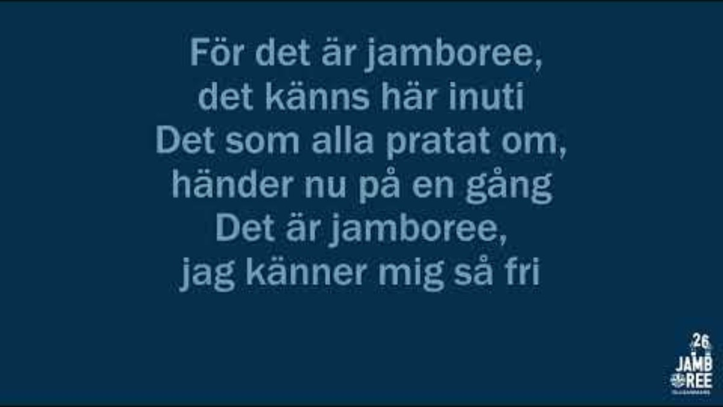
Our Jamboree song "Together is the real thing" feat. Stina Joza

Slide 4
The agenda
The chat is staffed av volunteers from our planning organisation
They will answer questions continuously, and if time allows, we will also address common questions aloud at the end. All questions aid in improving the information in future newsletters and on the website.
General info
Village allocation and site info
Travel and transport
Info about food
Programme and the Together Party
Questions in the chat

Slide 5
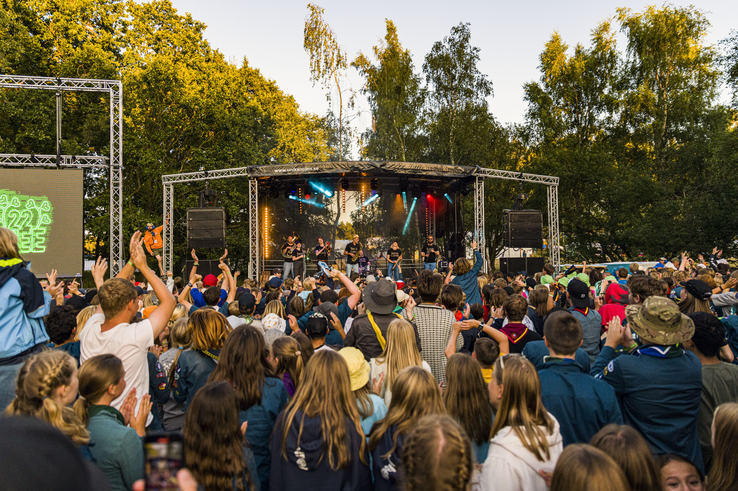
Over 17 000 guides and scouts!!
2000 international guides and scouts
570 scout groups
245 villages
An amazing camp that we make together.

Slide 6
Reduces fees
Participant 2600 kr
Leader 2100 kr
Participant short week 1350 kr
Leader short week 1100 kr
Leader-Staff 1300 kr
Leader's child 2-10 år 700 kr
Leader's child short week 400 kr
Leader's child under 2 år 0 kr
Many more registrations → more people sharing the fixed costs.
Unexpected support from sponsors and partners → lower costs than planned.
This allows us to charge a lower fee while still delivering an unforgettable camp!
Invoices have not yet been sent, as we were waiting for the decision on reduced fees. They will be sent soon.

Slide 7

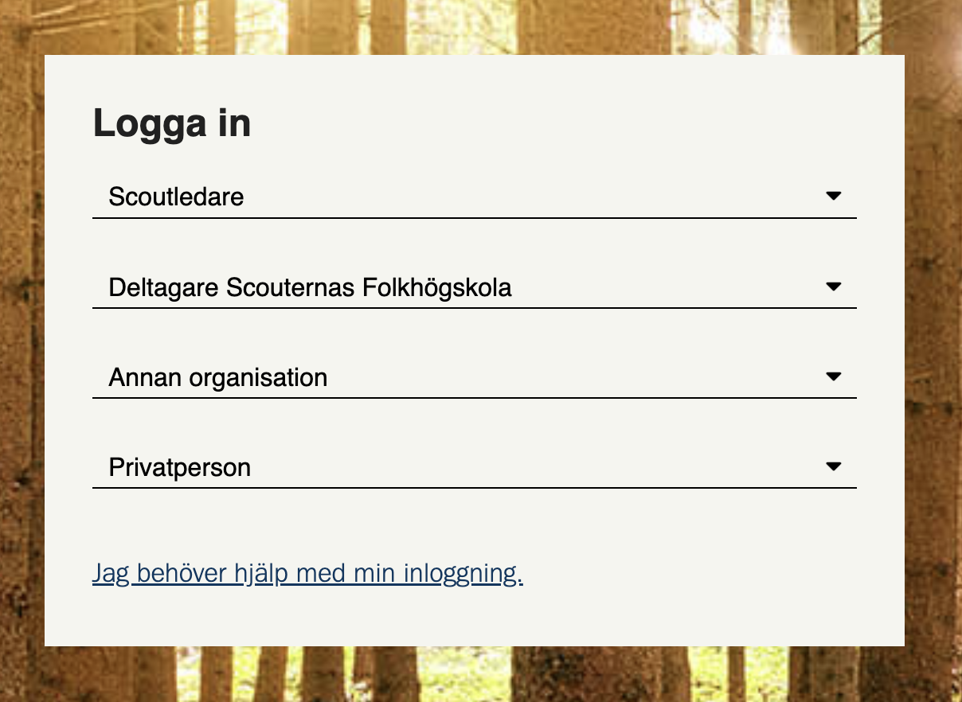
Safe from Harm
Everyone aged 18 and above who is participating as a Leader or Camp staff must complete the Swedish version of Safe from Harm.
No other version is accepted.
We will send a link via email.
It must be completed no later than the day you arrive at the camp site.

Slide 8
Village allocation and site information

Slide 9
Village allocation
All scout groups has received an email about which other groups there are in your village.
The email includes contact details for each group’s designated contact person.
Please, get in touch and plan together!
Help each other with equipment.
Every group must bring own tents for sleeping.

Slide 10
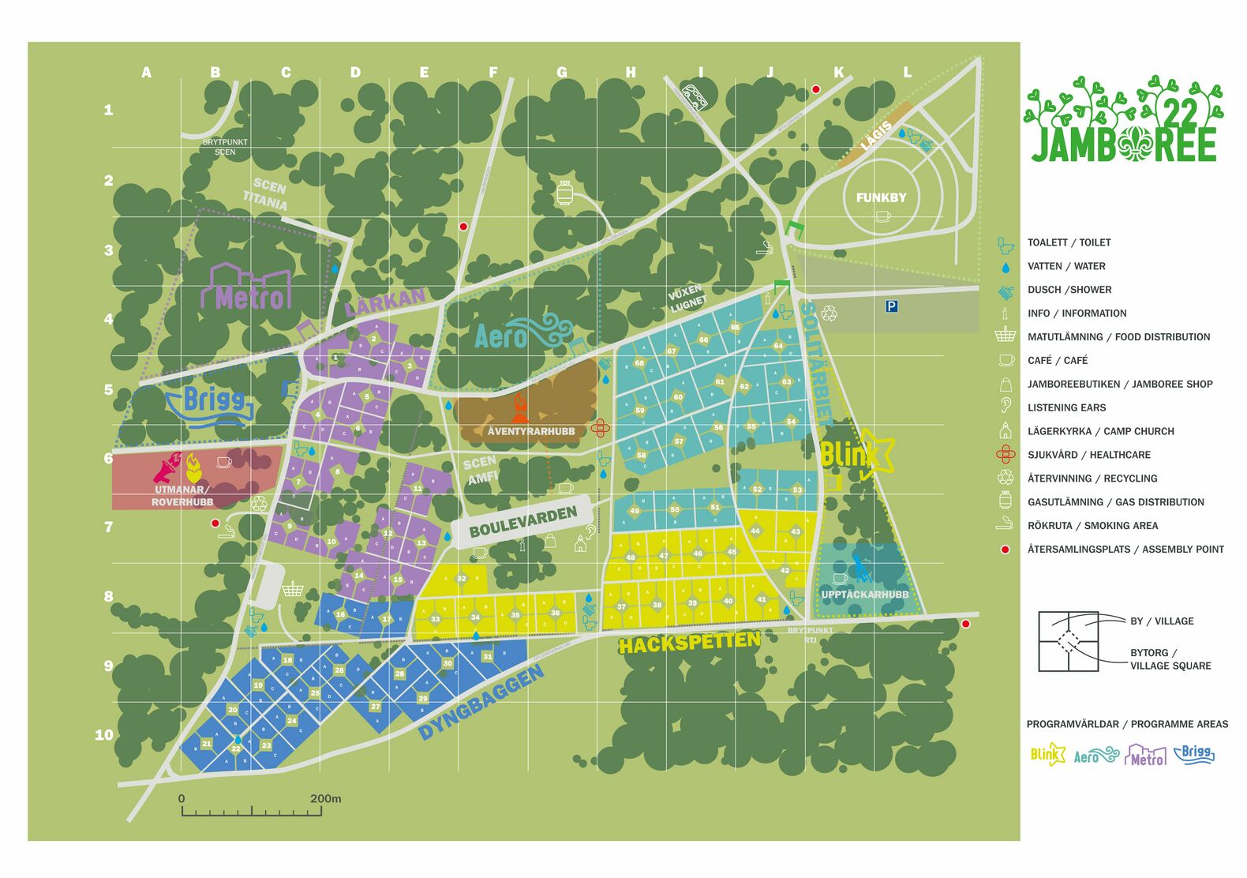
Map
Later this spring, groups will receive both an overview map and a detailed map.
This map is from Jamboree22.
Jamboree26 is situated on the same field, but differently planned.

Slide 11
Hygiene
Toilets
Both flush toilets and dry toilets
Urinals
Accessible toilets
Showers
Shower trailers all with individual stalls
Accessible showers
Hygiene in the village
Tooth brushing
Hand washing, face washing
The Jamboree26 way

Slide 12
Water and waste
Water
Collect in containers from the water stations.
Greywater
Gather in a suitable container in the village and take to designated disposal points on the camp site.
All water must be filtered so that no food waste is included.
Waste sorting
Plastic packaging
Paper/cardboard packaging
Metal packaging
Food waste
Residual waste
Corrugated cardboard
Coloured glass
Clear glass
The Jamboree26 way

Slide 13
Poles, Gas and Firewood
Poles
1 pole per participant
Gas
The current limit is 60 litres (2 P11 cylinders). More information will be provided depending on village size.
Coordination with the emergency services is ongoing.
Gas cylinder exchange will be available (details on models and pricing will be shared later).
Firewood
Jamboree26 does not provide firewood.
The past summers there has been a fire ban.
Prepare an alternative way of cooking.
The Jamboree26 way

Slide 14
Safety
Safety planning
Contingency planning and risk management is ongoing.
Safety hosts on site
Collaboration with the police and emergency services.
Medical care at the camp
Scout groups are responsible for basic first aid themselves.
Health care volunteers are on site to assist with more serious injuries and illnesses.
Defibrillators are available on the field.
Listening Ears
Support for children and young people.
A trusted adult to talk to.
The Jamboree26 way

Slide 15
Travel and transport

Slide 16
Travel sustainably with your group
Go by train to Kristianstad C
Local transport: Skånetrafiken
Stop: Norra Åsum Wendesgymnasiet
We will send more information regarding timetables.
No shuttle buses are provided by the Jamboree26
Update your travel information in your registration.

Slide 17
Travel with car or bus
Arrival with Trailer
Entry on the 24 July, the day before the jamboree starts, is permitted between 08:00–20:00.
Drivers and passengers may stay overnight in their subcamp. Expect limited services and arrange your own food.
Trailers may remain in the subcamp as they are then considered tents and then must follow the same spacing rules as tents.
Entry during the camp period is also possible.
Arrival with Bus Arrival with bus to designated parking area for buses.
The group unloads and transports the equipment to their subcamp themselves.
Departure with Trailer
It is possible to roll empty trailers into the area if the established rules are followed.
No loaded trailers may be moved by hand within the area.

Slide 18
Shipping goods
The scout group books transport with delivery between 13–21 July and pickup between 3–7 August.
The camp will transport the goods to your village.
Items must be packed on pallets with pallet collars and a lid, maximum 7 collars high, with no parts sticking out.
Pack everything to be weatherproof, as it will be stored outdoors on the field.
Packing materials are stored in the village during the camp week. Address and further details are available on the website, jamboree.se.

Slide 19
Information about food

Slide 20
Food philosophy Jamboree26
Food that tastes good and that I look forward to. Food that gives me the energy for adventures.
Theme is Together.
Good food shouldn’t taste weird — and it shouldn’t harm the planet either.

Slide 21
Food philosophy Jamboree26
How? Fixed recipes, but with room to make your own variations. A varied menu, with both meat and vegetarian options.
We aim to introduce meals and ingredients that may be completely or partly new to our scouts — for example, swapping rice for Swedish-grown oat grains.
All groups cook the food for themselves.
We want to inspire positive eating habits by encouraging a more sustainable food system.
Eating in an environmentally friendly way can appear more familiar than we might think.

Slide 22
Food distribution
and refrigerated containers
Food is collected at the assigned time for your village.
In general, you pick up the items yourselves.
Some food items are handed out in fixed quantities over the counter, for example protein items.
Staple items are collected on the first day of the camp and then restocked as needed.
Villages located near each other share the same refrigerated container.
Chilled items should be placed in the container.
Other food is stored in the village.
Leftovers can also be stored in the refrigerated containers to reduce food waste.

Slide 23
Dietary restrictions
It shouldn’t be complicated to manage dietary restrictions at camp.
The food distribution area has a special diets section where registered dietary needs can be collected.
You may be contacted by the food team if your group has specific allergies or dietary restrictions.
Gluten-free, lactose-free, milk protein-free, vegetarian, vegan, nuts, legumes, eggs — no problem.
The Jamboree26 way
Update dietary information in your registration.

Slide 24
Programme and the Together Party

Slide 25
Time for arrival and departure
Jamboree26 starts 25 July
You may arrive at any time during Saturday — groups will be arriving throughout the day.
If you are bringing equipment by car and trailer, this need to arrive one day earlier.
The first meal at the jamboree will be dinner.
The official opening ceremony will take place on Sunday July 26th.
Jamboree26 closes 1 August
The amazing closing ceremony will take place on Friday evening.
On Saturday, there is no set schedule and groups may leave the camp whenever suitable.
The final meal of the camp will be lunch on Saturday.
It will be something easily prepared and to go.

Slide 26




Programme and weekly schedule
Programme activities in patrols every day.
Patrols of 4–7 participants.
Activity sessions take place either in the morning or the afternoon.
Discoverers (10-11) must have a leader, Adventurers (12-15) should have a leader.
Programme is divided into 5 themes .
One for each full day of the camp .
One is located in Kristianstad city.
The hubs are open for most of the day.

Slide 27

Hubs
Social areas for each age group. Meet friends, play games, hang out.
Some evenings offer activities like karaoke and disco.
Shop at the café. Card payments are mainly used throughout the camp.
The Jamboree26 way

Slide 28
The Together Party
On Tuesday evening, it’s time for the Together Party — everyone helps create the celebration!
It’s all about togetherness, co-creation, and joy.
Each scout group can make their own part to the party.
How can you contribute? Choose one or more: Food, drinks, music, dance, performances, costumes, games, decorations, or capturing memories!
Examples of things your village can do:
Small tasting samples that can be eaten from a mug or by hand
Offer an exciting drink
Games and competitions, perhaps using recycled materials
Organise a dance parade through the village
Face painting
Music in different forms
Decorations that make your space feel magical

Slide 29
Important things to keep in mind for the Together Party
No alcohol is permitted at any time during the jamboree.
Use recycled and second-hand materials whenever possible. Avoid single-use items.
Food and drinks must have a clear list of ingredients.
No sharp objects may be thrown.
Any type of open fire must be reported to Safety and follow their guidelines.
Have a clear plan for waste and rubbish.
Leaders are responsible for their scouts, as usual.
Make sure no one goes missing, is left alone, or behaves in a way that creates an unsafe situation for themselves or others.
Listening Ears will be available, and safety hosts will be present around the area.

Slide 30

Programme for Rovers
For leaders and volunteers aged 18–25.
Separate opening and closing ceremonies.
Programme sessions are offered both in the morning and afternoon — you can join whenever it fits your other responsibilities.
Activities may also be available later in the Rover Hub.
All Rovers are welcome, whether you signed up for it or not!
The Jamboree26 way

