Slide 1
This presentation is automatically translated from Swedish
Please adjust to your needs, and disregard strange wordings or translation errors. Thank you.

Slide 2
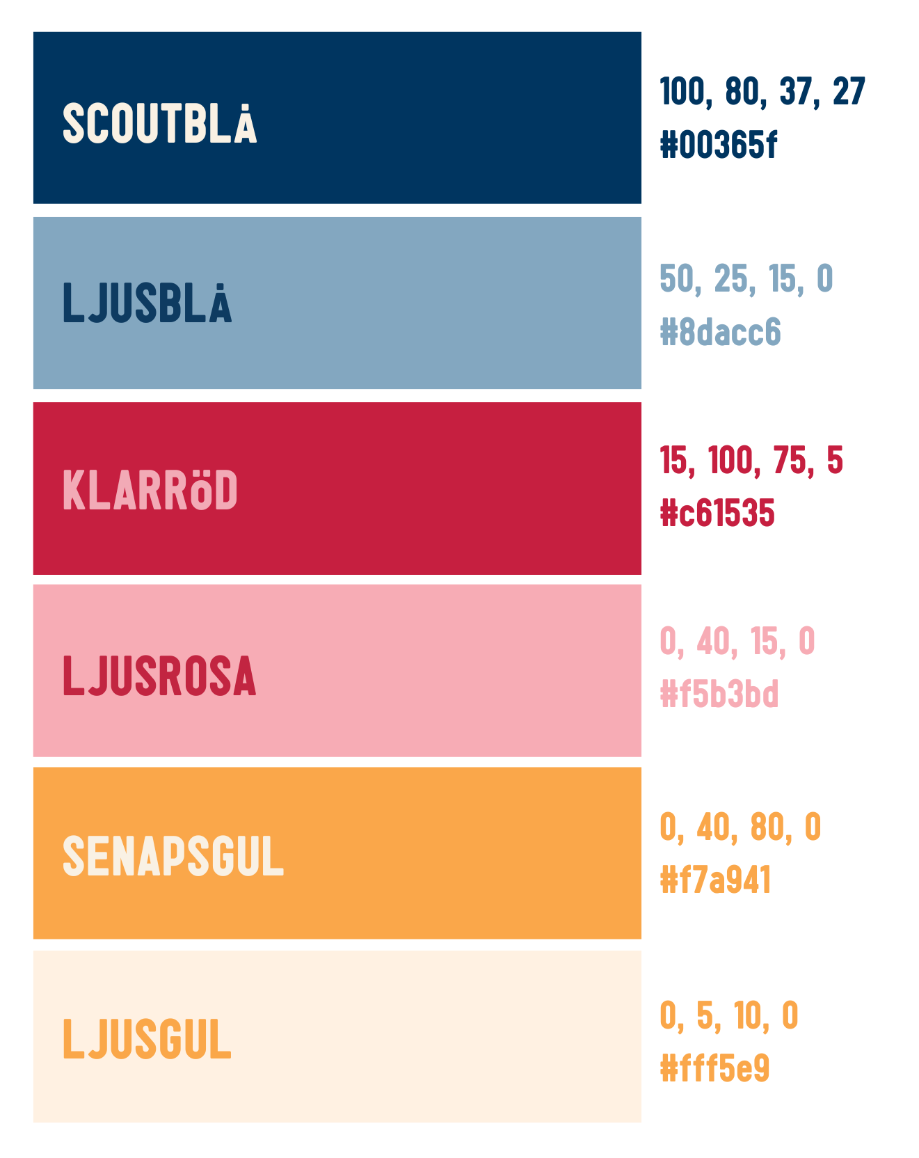

Image bank
Colors
For more, see the Scouts' image bank here
See the Scouts' media archive here
with Jamboree pictures here.
Keep in mind that colors of text and background have high contrast so it is easy for everyone to read
Typeface
Rubriker: Franklin Gothic Medium
Annan text i presentationen: Franklin Gothic Book Regular

Slide 3




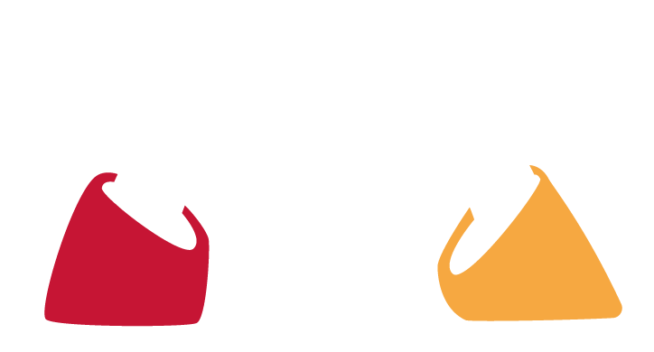




























Slide 4
Jamboree26
Sweden's national jamboree

Slide 5
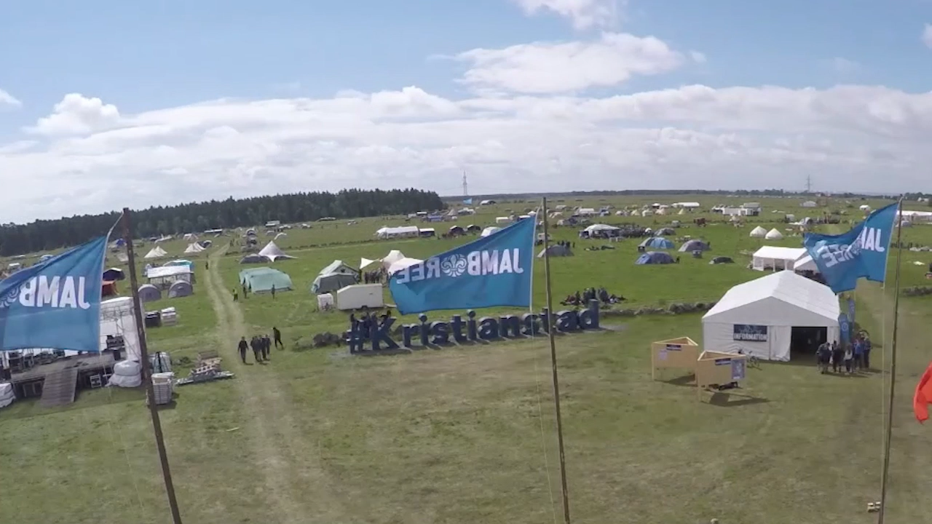
Notes:
Promo film for Jamboree26.
The movie has sound, so please make sure that speakers are plugged in and that the volume is at a good level.
The movie starts automatically when you switch to this slide.

Slide 6
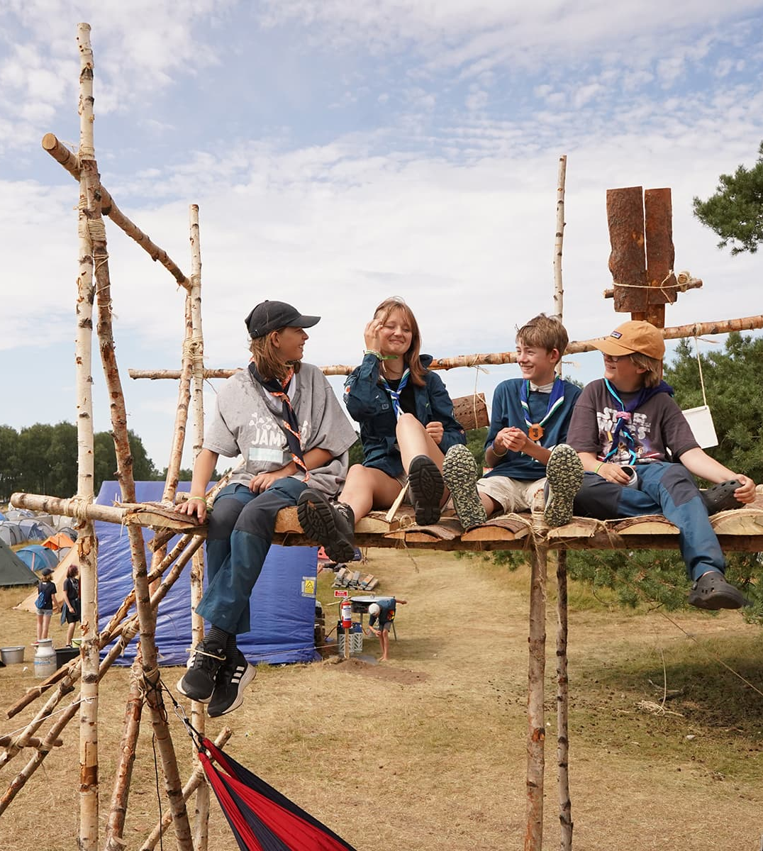
Swedish National Scout Jamboree
Camp for all Scouts in Sweden, all associations
Experience community, be inspired and see the breadth of the movement
Develops applications, content, and experiences
Notes:
Next summer it's time again for the Swedish national jamboree!
A national jamboree is a joint camp for all scouts throughout Sweden, and international guests are also welcome. In Sweden, we have a national jamboree every four years, and we have previously had it in 2017 and 2022.
In addition to the fact that it is super fun with the national jamboree, it is also a unique opportunity both for all scouts and for us as a corps to experience the scout movement's community, to be inspired by others and to see the breadth of the movement.
With the help of the national jamborees, we – that is, all of us Scouts in Sweden – can develop our Scout program, content and experiences, and we can then use it in different ways even after the jamboree.

Slide 7
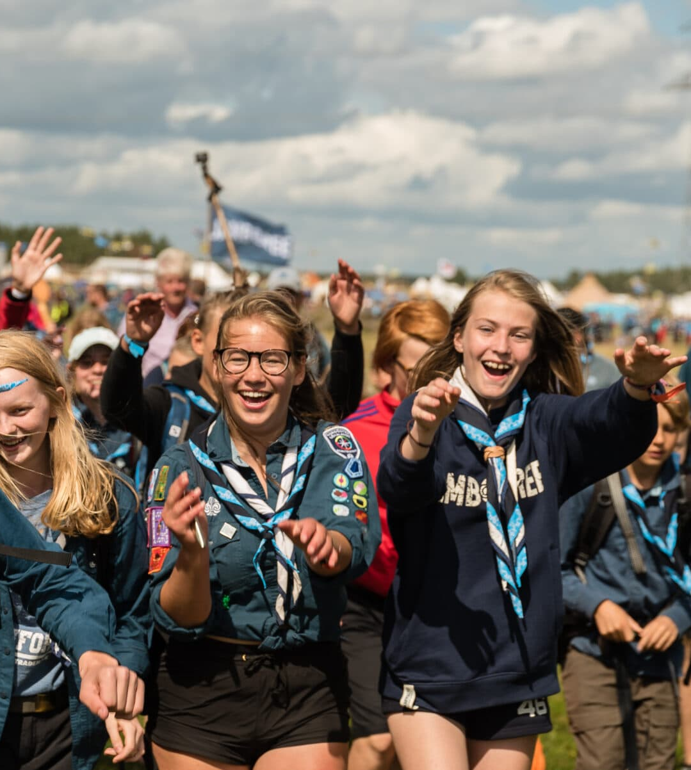
Jamboree26
July 25 – August 1
Norra Åsum, Kristianstad
Theme: Together
10,000–15,000 Scouts
Of which 1000–2000 foreign
Notes:
And next summer it's time again! Then all of Sweden's scouts gather once again to celebrate the jamboree, and this time it's Jamboree26.
Jamboree26 takes place from July 25 to August 1. For volunteers, the camp starts on July 22 and ends on August 3.
The campsite is the same as for Jamboree22, Norra Åsum outside Kristianstad. It is a large event field owned by Kristianstad municipality. The municipality has already arranged a lot of practical infrastructure such as water, sewage and fiber cables, but in addition to that, it is an empty field where we will build up an entire city for a week!
Each national jamboree has a theme, and at Jamboree26 the theme is: Together. Broadly speaking, it is about things like participation, democracy, community and that we are stronger together.
There is already a huge interest from foreign scout groups to come to Jamboree26, for example from countries such as Australia, Austria, Bangladesh, Belgium, Canada, Czech Republic, Estonia, Finland, France, Germany, Ireland, Kenya, Liberia, Norway, Pakistan, Sierra Leone, Switzerland, Uganda, United Kingdom, USA

Slide 8
How do we go?
[fill in information about the trip]
Notes:
Jamboree26 is for ALL scout groups in Sweden, regardless of the collaboration organization.
The program at the camp will be adapted for explorers and up, but trackers can also participate if the corps wants to bring them as well. The trackers will then be allowed if they want to be part of the discovery program, but it may require a little extra leadership support, and they will be able to hang out in the discovery hub.
Also for leaders and functionaries, there will be activities, hangouts and fellowship that you can do in your free time.
If you are a rover scout, i.e. between the ages of 18 and 25, there will also be a special rover program, and that is something that is completely new to this jamboree. The rover program will be adapted so that you can participate in it alongside your volunteer or leadership assignment at the camp.

Slide 9
Theme: Together
Participants ➡️ Co-creators
Arenas, opportunities and forums
Democracy
Having someone by your side
Listen, make your voice heard and be listened to
A unified Scout movement
Notes:
The theme of Jamboree26 is Together. This means that we all create the camp together.
We want all scouts, all corps, instead of feeling that they just go and "consume" the jamboree, that they are there and are co-creators. Everyone is part of the camp and together we create Jamboree26.
We don't know exactly how it will take concrete expression at the camp yet, but there are lots of ideas and it's only the imagination that sets the limits.
There will be extra many arenas, opportunities and forums where everyone is involved and co-creates the camp and the experience in different ways.
An important part of this is also the democracy aspect, because if we are all to be involved in creating Jamboree26, everyone must be given the chance to make themselves heard and we must work together in democratic forms.

Slide 10
A day at Jamboree26
Morning – program
Lunch at the village
Afternoon – hub time
Dinner in the village
Evening – hub time, party or show
Notes:
So, what can a day at Jamboree26 look like?
In the morning, the idea is that there is a program. The program will be different for each age group and it will be based on the five areas of development in the Scouts' new program platform: the mind, the body, the group, life issues and emotions
Lunch and dinner you will eat with the corps in your camp village.
In the afternoon, the various age hubs are open, where there are lots of fun spontaneous activities and cafés, where you can hang out and have fun with your friends and meet new friends from other unions. There will also be different center squares, and the Camp Shop and various exhibitors.
In the evening, the hubs are usually also open, but there can also be other activities then, such as an inauguration show, campfire or a Together party.

Slide 11
Registration
The troops register online via jamboree.se
Registration opens [opening] and closes [closes]
Notes:
The corps registers via Scoutnet, and the corps can also receive registrations from its members directly in scoutnet.
Registration opens at the end of October 2025 and closes sometime in February 2026. There will be the opportunity to register late for a higher fee.
Volunteers sign up directly for the camp via Scoutnet
Volunteer registration closes in April 2026

Slide 12
Participation fees
Scouts: [enter your fee]
Leader:
The fee includes camp fee, return trip and common equipment [add any additional that is included]

Slide 17
Notes:
Thanks!

